Slide 1

Obligatory Assignment 02
Due 27 Feb, 15.00

Slide 2
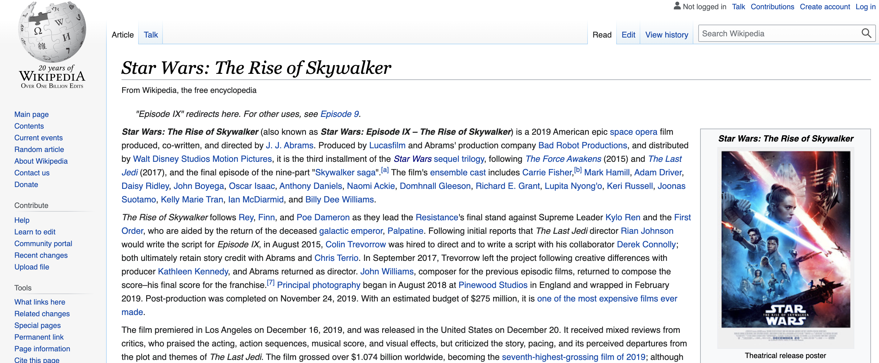
1. Extract following information from a wiki page:
In this assignment you will extract information from the following wiki page: https://en.wikipedia.org/wiki/Star_Wars:_The_Rise_of_Skywalker
1.1 You have to extract all links from the page as well as where they point to (tip: look for the “href” attribute in “<a>” tags). You must print out absolute link reference.
1.2 You have to extract all images src attribute from the page. You must print out absolute link reference.
Obligatory Assignment 02. (Due date: 27.02.2023)

Slide 3
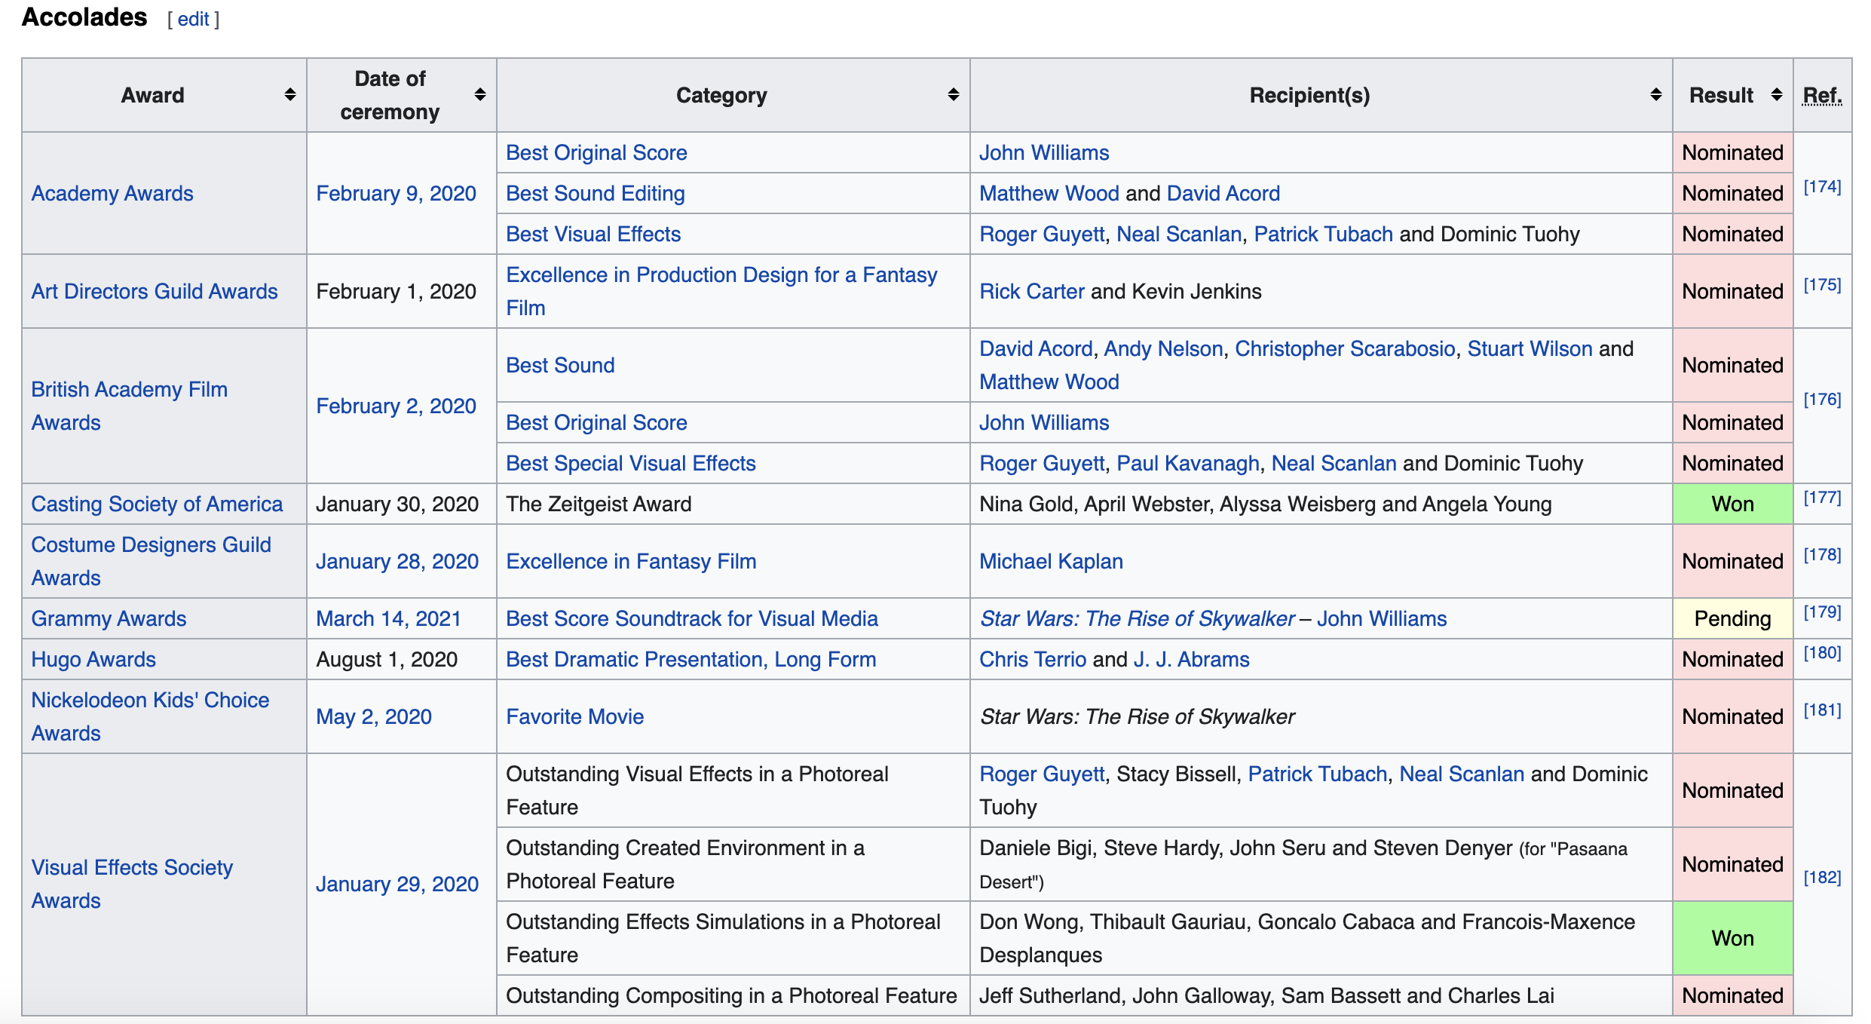
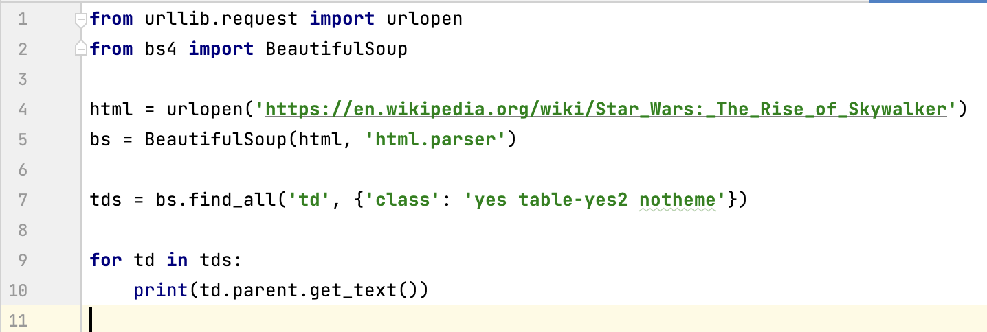
2.a) Analysing code.
https://en.wikipedia.org/wiki/Star_Wars:_The_Rise_of_Skywalker
The following python code is used to extract some information about the awards that the movie has won. With the following python code, we were able to select the table data that has 'Won' value and print out some related information by accessing its parent element. However, it is not printing the columns with Award, and Date of ceremony values for all selected items. Why it is not printing the column value for Award and Date of ceremony information for the selected awards? Analyse the table structure and python code and provide an answer in plain text (max length 100 words). Optional: You may provide a DOM tree with your answer.
Obligatory Assignment 02. (Due date: 27.02.2023)

Slide 4
2.b) Fixing python code (Optional task)
https://en.wikipedia.org/wiki/Star_Wars:_The_Rise_of_Skywalker
Can you fix the following python code to extract some information about the awards that the movie has won. How to ensure that the code prints the columns with Award, and Date of ceremony values for all selected items.
Obligatory Assignment 02. (Due date: 27.02.2023)

Slide 5
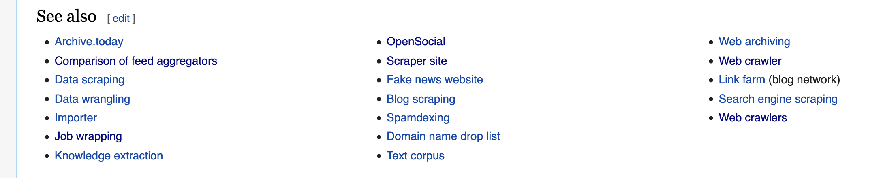
3. In this assignment you have to write a scraper that will work as follows.
a. Start crawling from https://en.wikipedia.org/wiki/Web_scraping
b. Using BeautifulSoup's find_all() function get all the links from 'See also' section
c. for each link do the following
c.1 Load selected article page
c.2. Print out selected articles first paragraph.
Note: Consider including basic error handling.
'See also' section of https://en.wikipedia.org/wiki/Web_scraping
Obligatory Assignment 02. (Due date: 27.02.2023)

Slide 6
How to hand over the assignment?
You have to submit separate files including python programs for tasks 1, 2.a and 3. Task 2.b is optional.
Your program should include brief comments providing high level descriptions of what the program is doing.
It is very important that your program should not have any syntax error at the time of submission.
You have to submit 1 word document for task 2.a.
Make a zip file that includes the word document and python programs.
Upload the zip file in the assignment page.
Note:: Do not delete the projects from your computer until your assignment is approved. Seminar leader will contact you if they need more information about your projects. For example, you may be asked to provide more comments on some code fragments e.g., functions, loops, etc.
Obligatory Exercise

